Slide 1
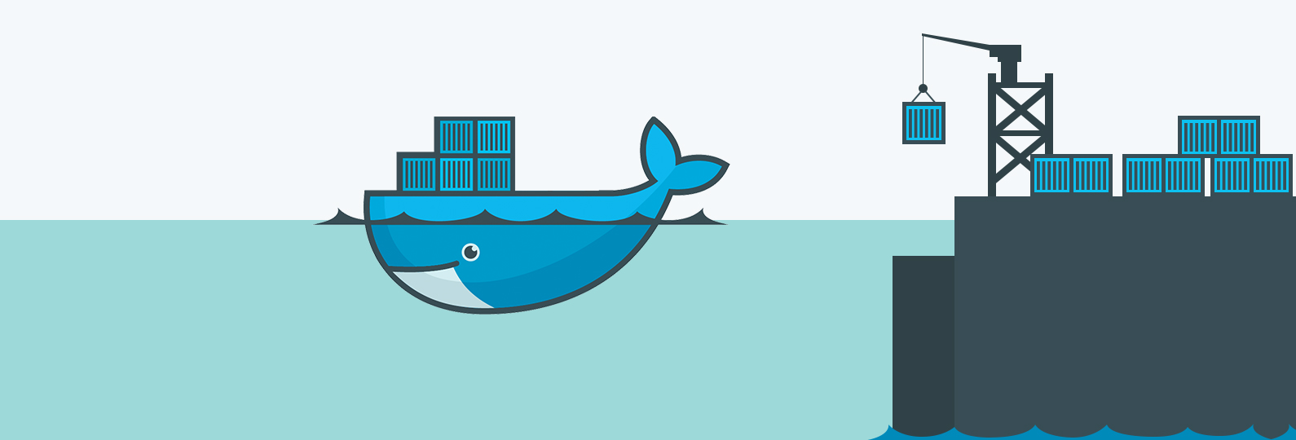
DOCKER Basics
Binil raj

Slide 2
Docker -
Docker is a container management service. The keywords of Docker are develop, ship and run anywhere. The whole idea of Docker is for developers to easily develop applications, ship them into containers which can then be deployed anywhere.
The initial release of Docker was in March 2013 and since then, it has become the buzzword for modern world development, especially in the face of Agile-based projects.

Slide 3
Container
A container is a standard unit of software that packages up code and all its dependencies, so the application runs quickly and reliably from one computing environment to another. A Docker container image is a lightweight, standalone, executable package of software that includes everything needed to run an application: code, runtime, system tools, system libraries and settings.

Slide 4
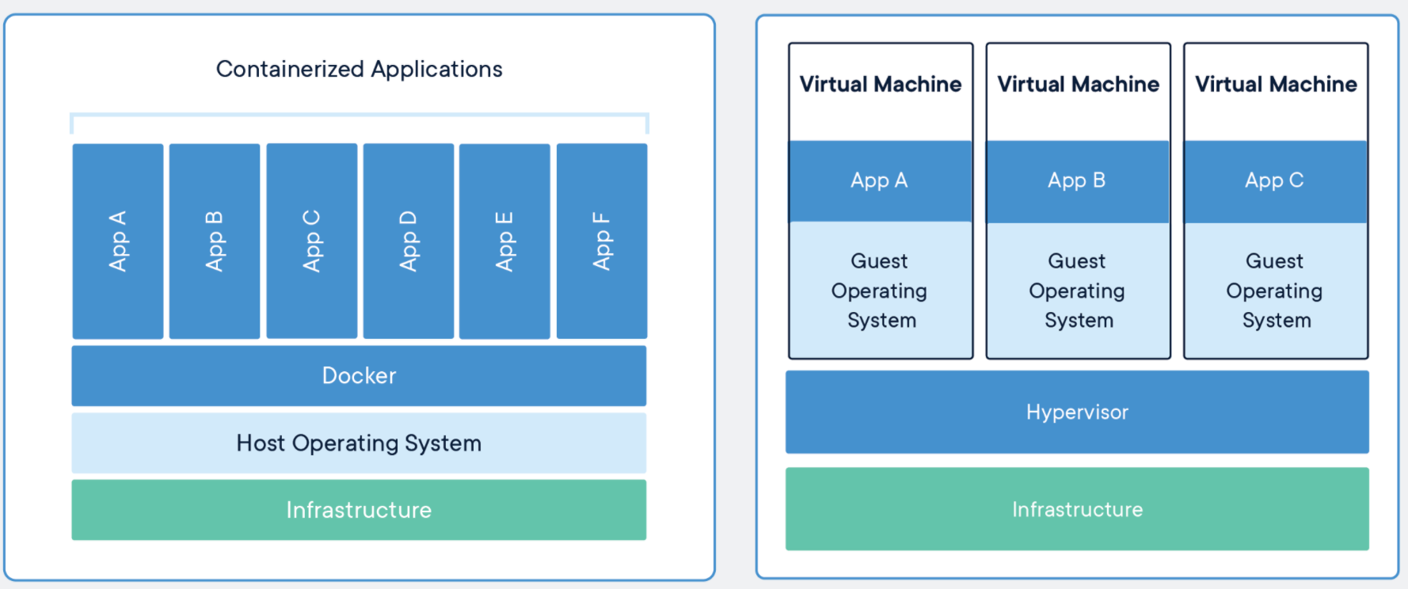
Layers in Containers and VM :

Slide 5
Containers and VM :
CONTAINERS
VIRTUAL MACHINES
Containers are an abstraction at the app layer that packages code and dependencies together. Multiple containers can run on the same machine and share the OS kernel with other containers, each running as isolated processes in user space. Containers take up less space than VMs (container images are typically tens of MBs in size), can handle more applications and require fewer VMs and Operating systems.
Virtual machines (VMs) are an abstraction of physical hardware turning one server into many servers. The hypervisor allows multiple VMs to run on a single machine. Each VM includes a full copy of an operating system, the application, necessary binaries and libraries - taking up tens of GBs. VMs can also be slow to boot.

Slide 6
Docker Image
A Docker image is a file, comprised of multiple layers, that is used to execute code in a Docker container. An image is essentially built from the instructions for a complete and executable version of an application, which relies on the host OS kernel. When the Docker user runs an image, it can become one or multiple instances of that container.
A container that moves from one Docker environment to another with the same OS will work without any changes, since the image includes all of the dependencies needed to execute the code.
A Docker image includes the elements needed to run an application as a container -- such as code, config files, environment variables, libraries and run time. If the image is deployed to a Docker environment it can then be executed as a Docker container. The docker run command will create a container from a given image.

Slide 7
Docker images and layers
A Docker image is made up of multiple layers. A user composes each Docker image to include system libraries, tools and other files and dependencies for the executable code. Image developers can reuse static image layers for different projects. Reuse saves time, since a user does not have to create everything in an image.
Most Docker images start with a base image -- although a user can build one entirely from scratch -- with the build command. A Docker web server image can also be used to build a container. Each image has one readable/writable top layer over static layers. Layers are added to the base image, tailoring to the code so it can run in a container. Each layer of a Docker image is viewable under /var/lib/docker/aufs/diff, or via the Docker history command in the command line interface (CLI). By default, Docker shows all top-layer images, such as the repository, tags and file sizes. Intermediate layers are cached, which makes top layers easier to view. Docker utilizes storage drivers to manage contents of image layers.
When a new container is created from an image, a writable layer is also created. This layer is called the container layer, and it hosts all changes made to the running container. This layer can store newly written files, modifications to existing files and newly deleted files. The writable layer allows customization of the container. Any changes made to the writable layer are saved on that layer. Multiple containers can share the same underlying base image and have their own data state thanks to the writable layer.

Slide 8
Docker image repositories
Docker users can store images in private or public repositories, and from there can then deploy containers, test images and share them.
Docker offers Docker Hub, which is a cloud-based registry service that includes private and public image repositories. It also has Docker Trusted Registry, which adds image management and access control features.
Docker Hub is the world’s largest repository of container images with an array of content sources including container community developers, open-source projects and independent software vendors (ISV) building and distributing their code in containers. Users get access to free public repositories for storing and sharing images or can choose subscription plan for private repos.

Slide 9
Reference
https://docs.docker.com/

Slide 10
Dockerfile
A Dockerfile is a text document that contains all the commands a user could call on the command line to assemble an image. Using docker build users can create an automated build that executes several command-line instructions in succession.

Slide 11


Slide 12


